Slide 1
Movie Recommendation System
A Data-Driven Approach to Movie Recommendations Using Semantic Search
Name: Vikram Pratap Singh

Slide 2
Project Overview
Objective: Develop a Python application that recommends movies based on semantic search queries.
Key Features:
Semantic search powered by Sentence Transformers.
Filtering options based on IMDb scores and vote counts.
User-friendly interface with Streamlit.

Slide 3
Dataset Information
Dataset: Netflix Movie Titles Dataset
Data Source: GitHub Link
Key Columns Used:
Title
Description
Genres
IMDb Score
IMDb Votes

Slide 4
System Architecture
Steps Involved:
Extract and Load Data: Read dataset from the URL.
Text Processing: Combine title, description, and genres for embedding.
Embedding Generation: Use a pre-trained Sentence Transformer model.
Vector Indexing: Index embeddings using ChromaDB.
User Query Handling: Input query, generate embedding, and retrieve similar movies.

Slide 5
Application Workflow
Input: User provides a descriptive query (e.g., "heartfelt romantic comedy").
Query Embedding: Generate embedding for the query using the pre-trained model.
Cosine Similarity Calculation: Compute similarity between query embedding and movie embeddings.
Filtering: Apply IMDb score and vote count filters.
Output: Display top 5 movie recommendations.

Slide 6
Key Technologies
Python Libraries:
Streamlit (UI)
Sentence Transformers (Embedding)
ChromaDB (Vector Store)
Scikit-Learn (Cosine Similarity)
Pandas (Data Handling)

Slide 7
Code Implementation (Snippet)
Sample Code (Main Logic):
query_embedding = model.encode([user_input])
similarities = cosine_similarity(query_embedding, embeddings).flatten()
top_indices = np.argsort(similarities)[::-1][:5]
for idx in top_indices:
st.write(f"{df['title'][idx]} (IMDb Score: {df['imdb_score'][idx]})")

Slide 8
Application Demo
Instructions to Run:
Run the app locally with Streamlit.
Access via Google Colab using a remote URL.

Slide 9
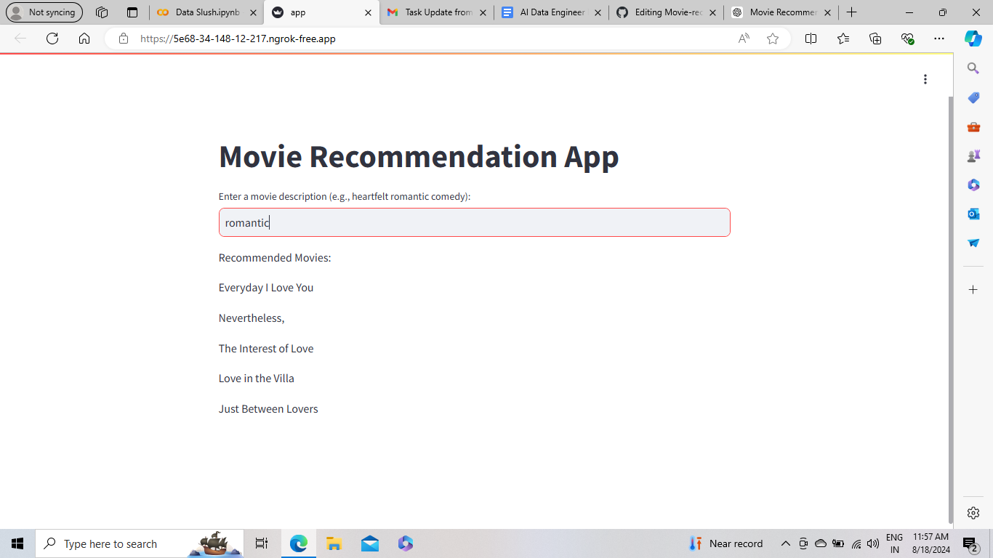
This is how the website appeared?

Slide 10
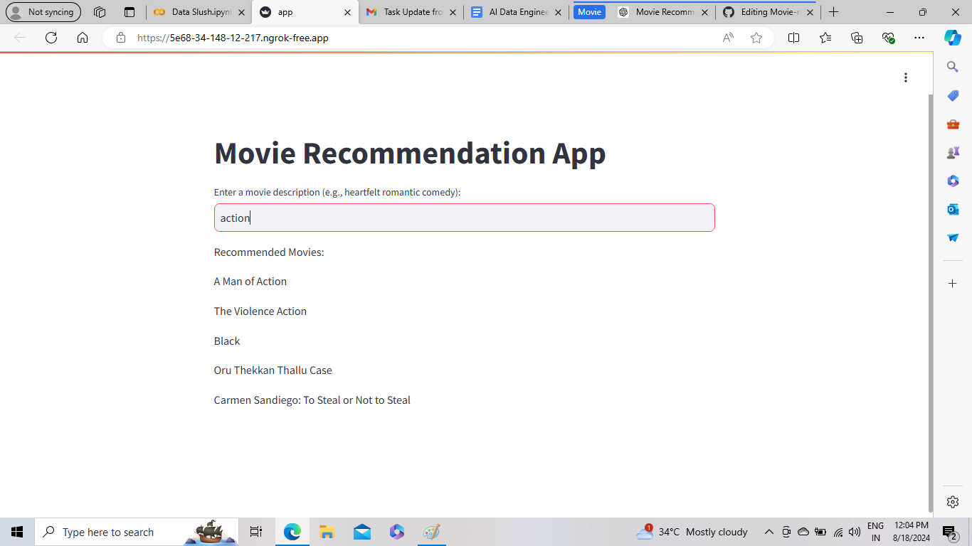

Slide 11
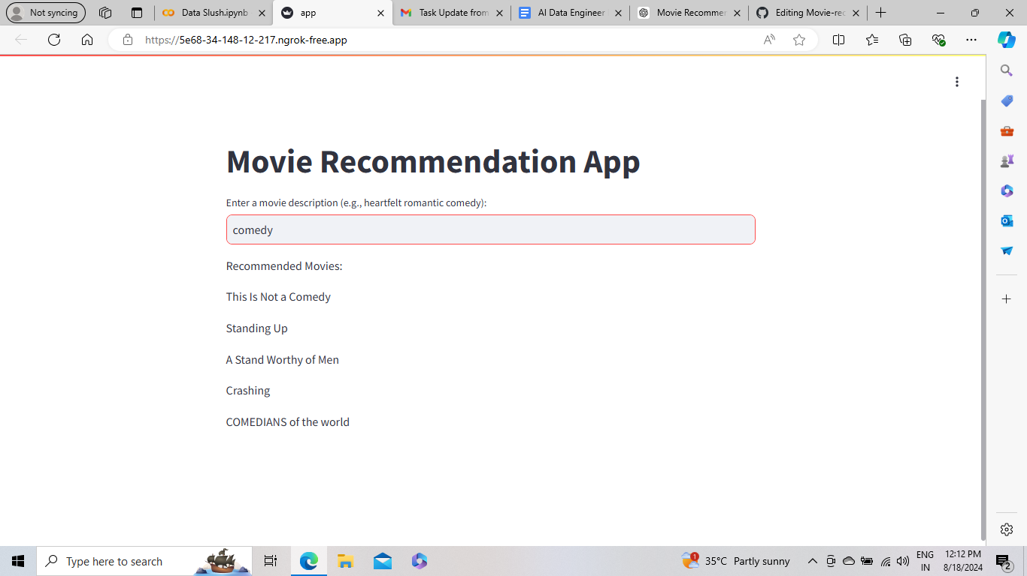

Slide 12
Future Improvements
Enhancements Planned:
Multi-field search (actor, director, etc.).
Enhanced UI/UX.
Personalized recommendations.
More advanced filters (runtime, release year, etc.).

Slide 13
Conclusion
Summary:
Successfully built a data-driven movie recommendation system.
Leveraged semantic search and vector stores for accurate results.
Easy-to-use interface with powerful filtering options.

